Slide 1
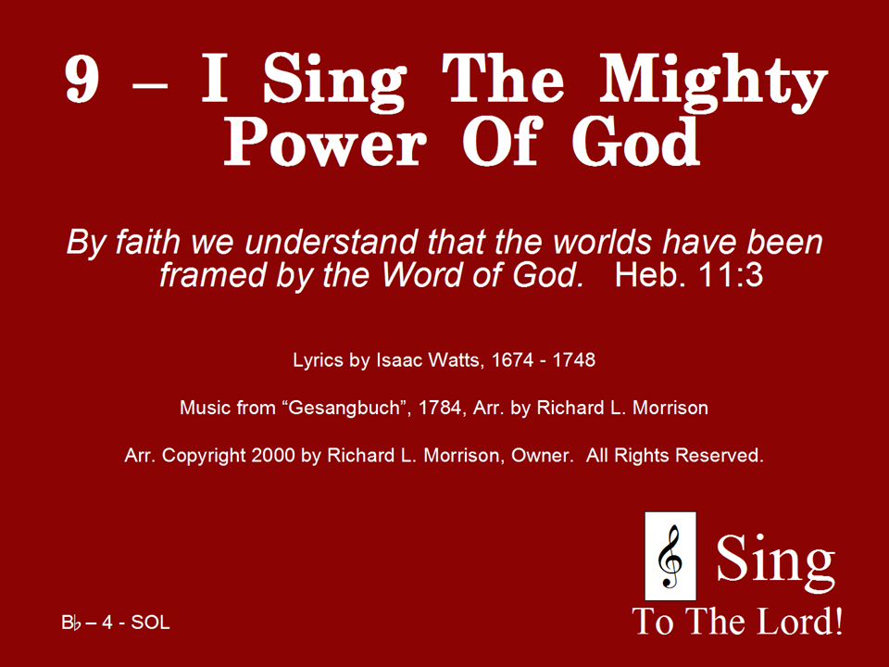
009 - I Sing The Mighty Power Of God - Title

Slide 2
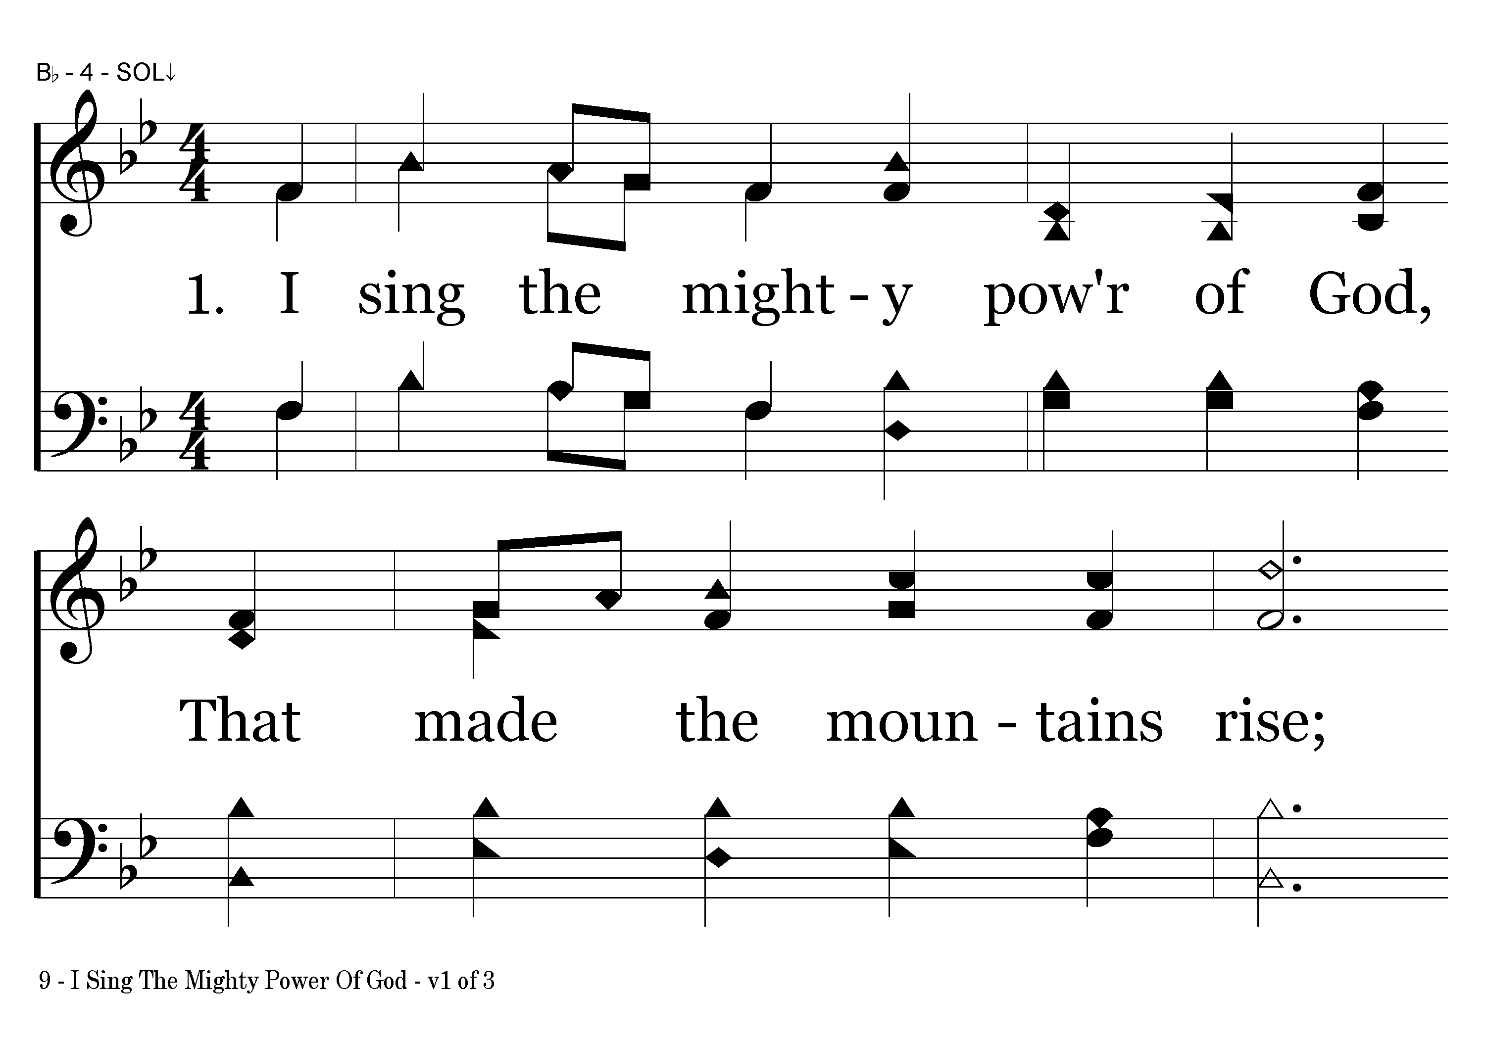
009 - I Sing The Mighty Power Of God - 1.1

Slide 3
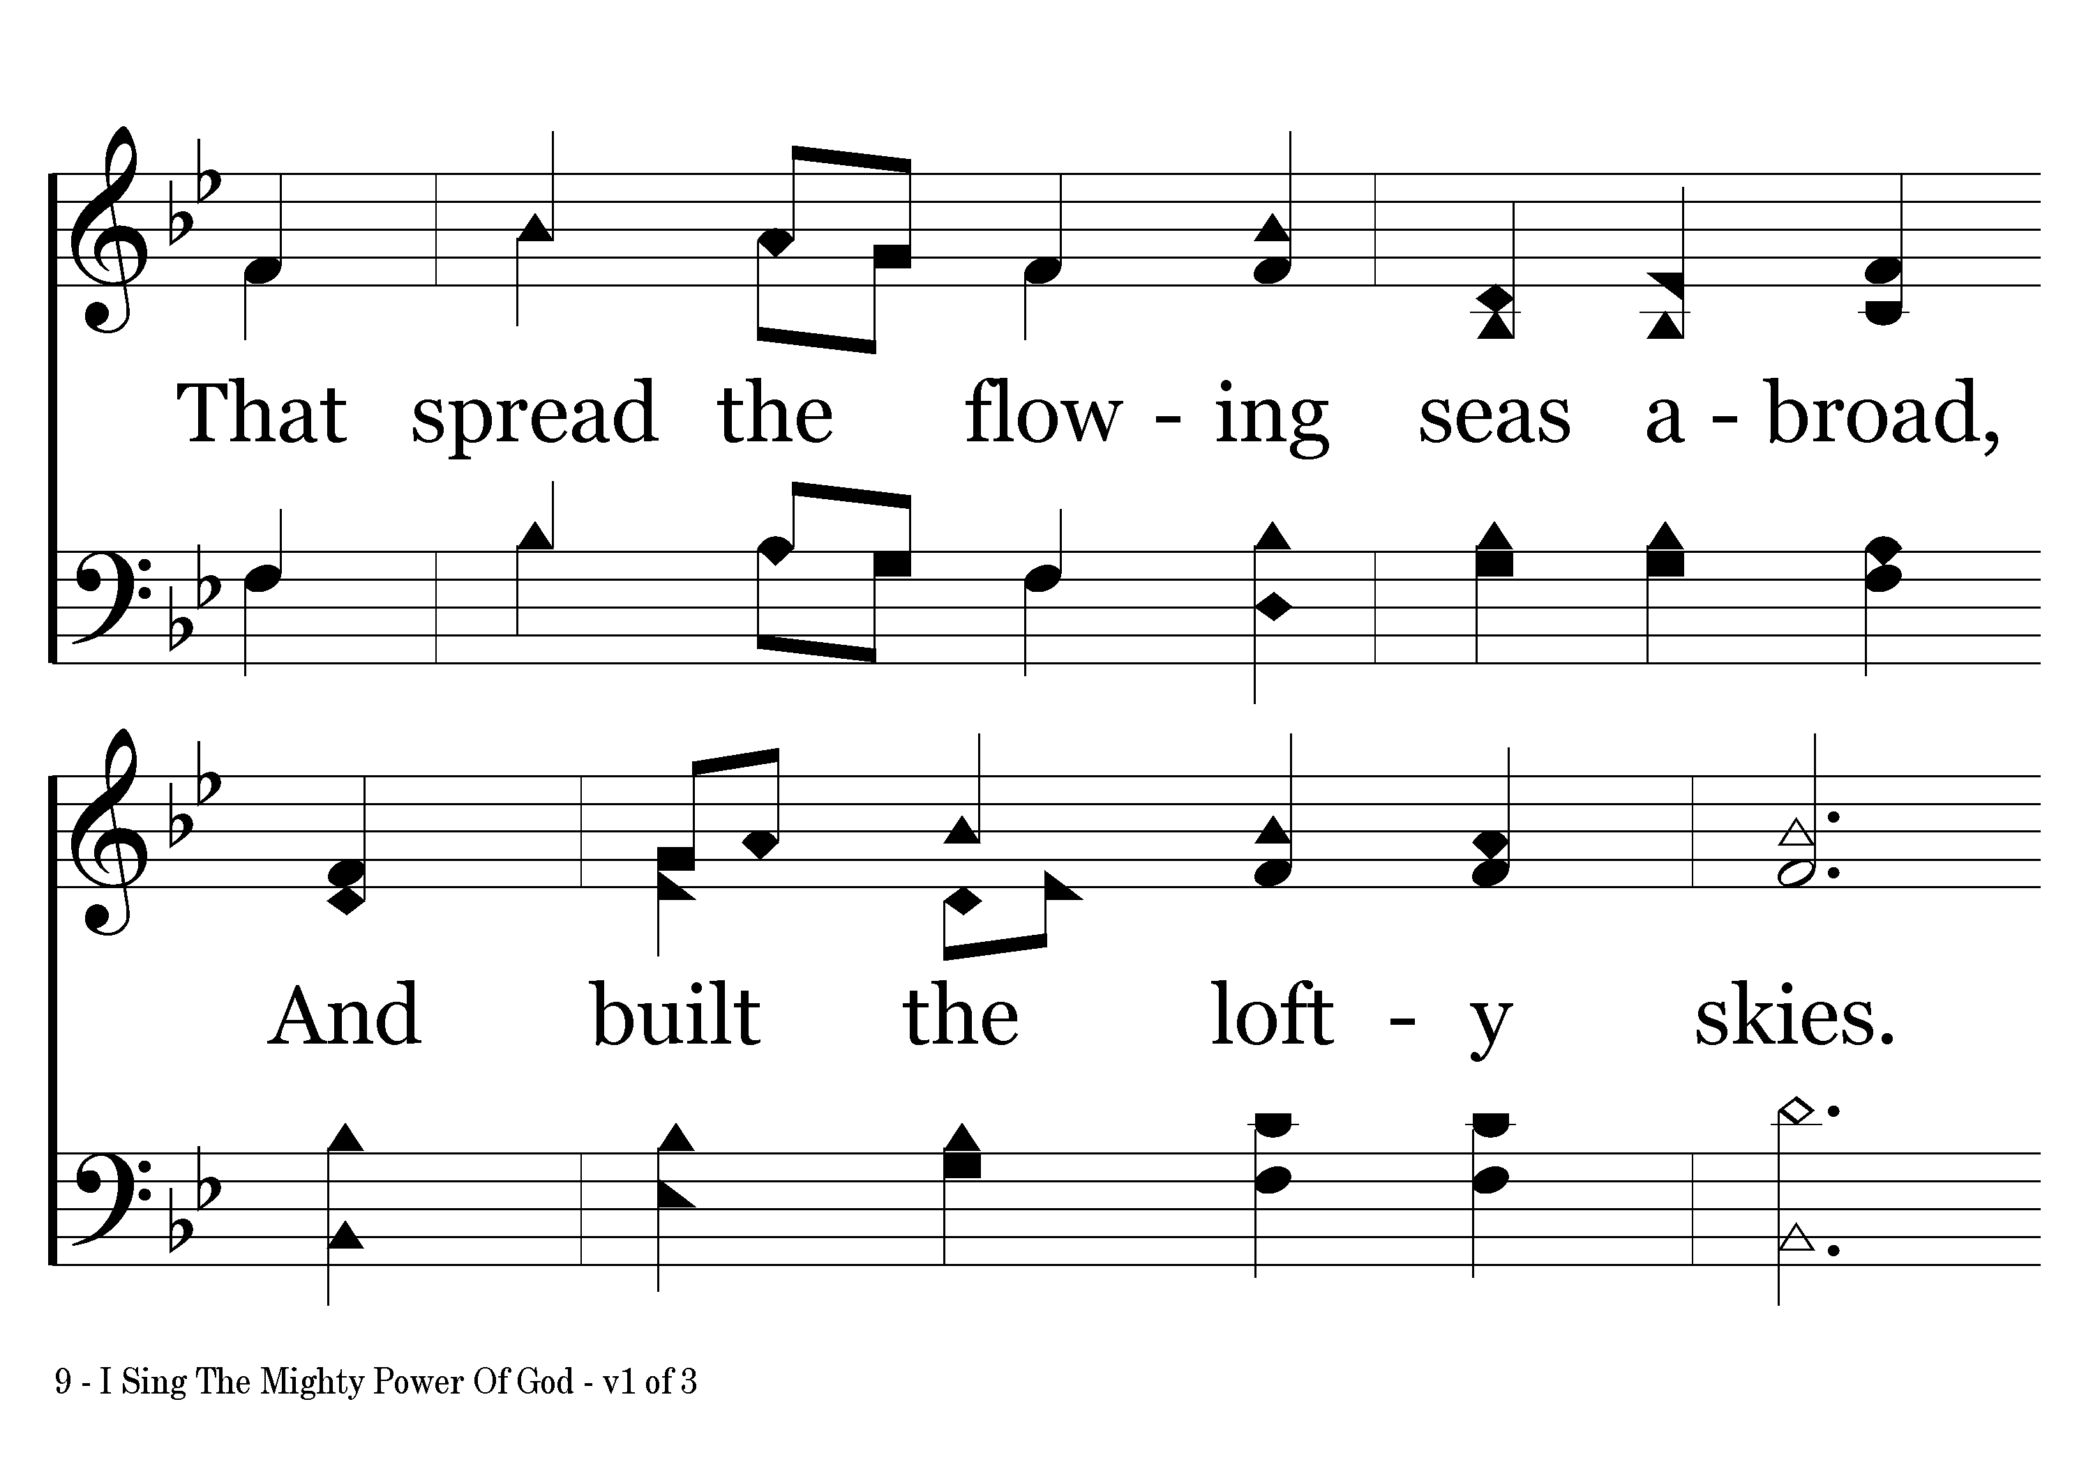
009 - I Sing The Mighty Power Of God - 1.2

Slide 4
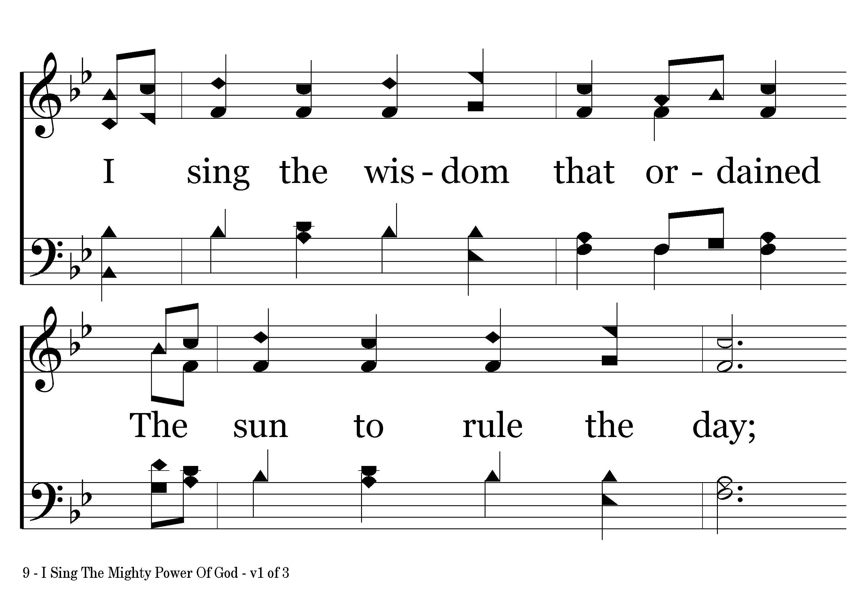
009 - I Sing The Mighty Power Of God - 1.3

Slide 5
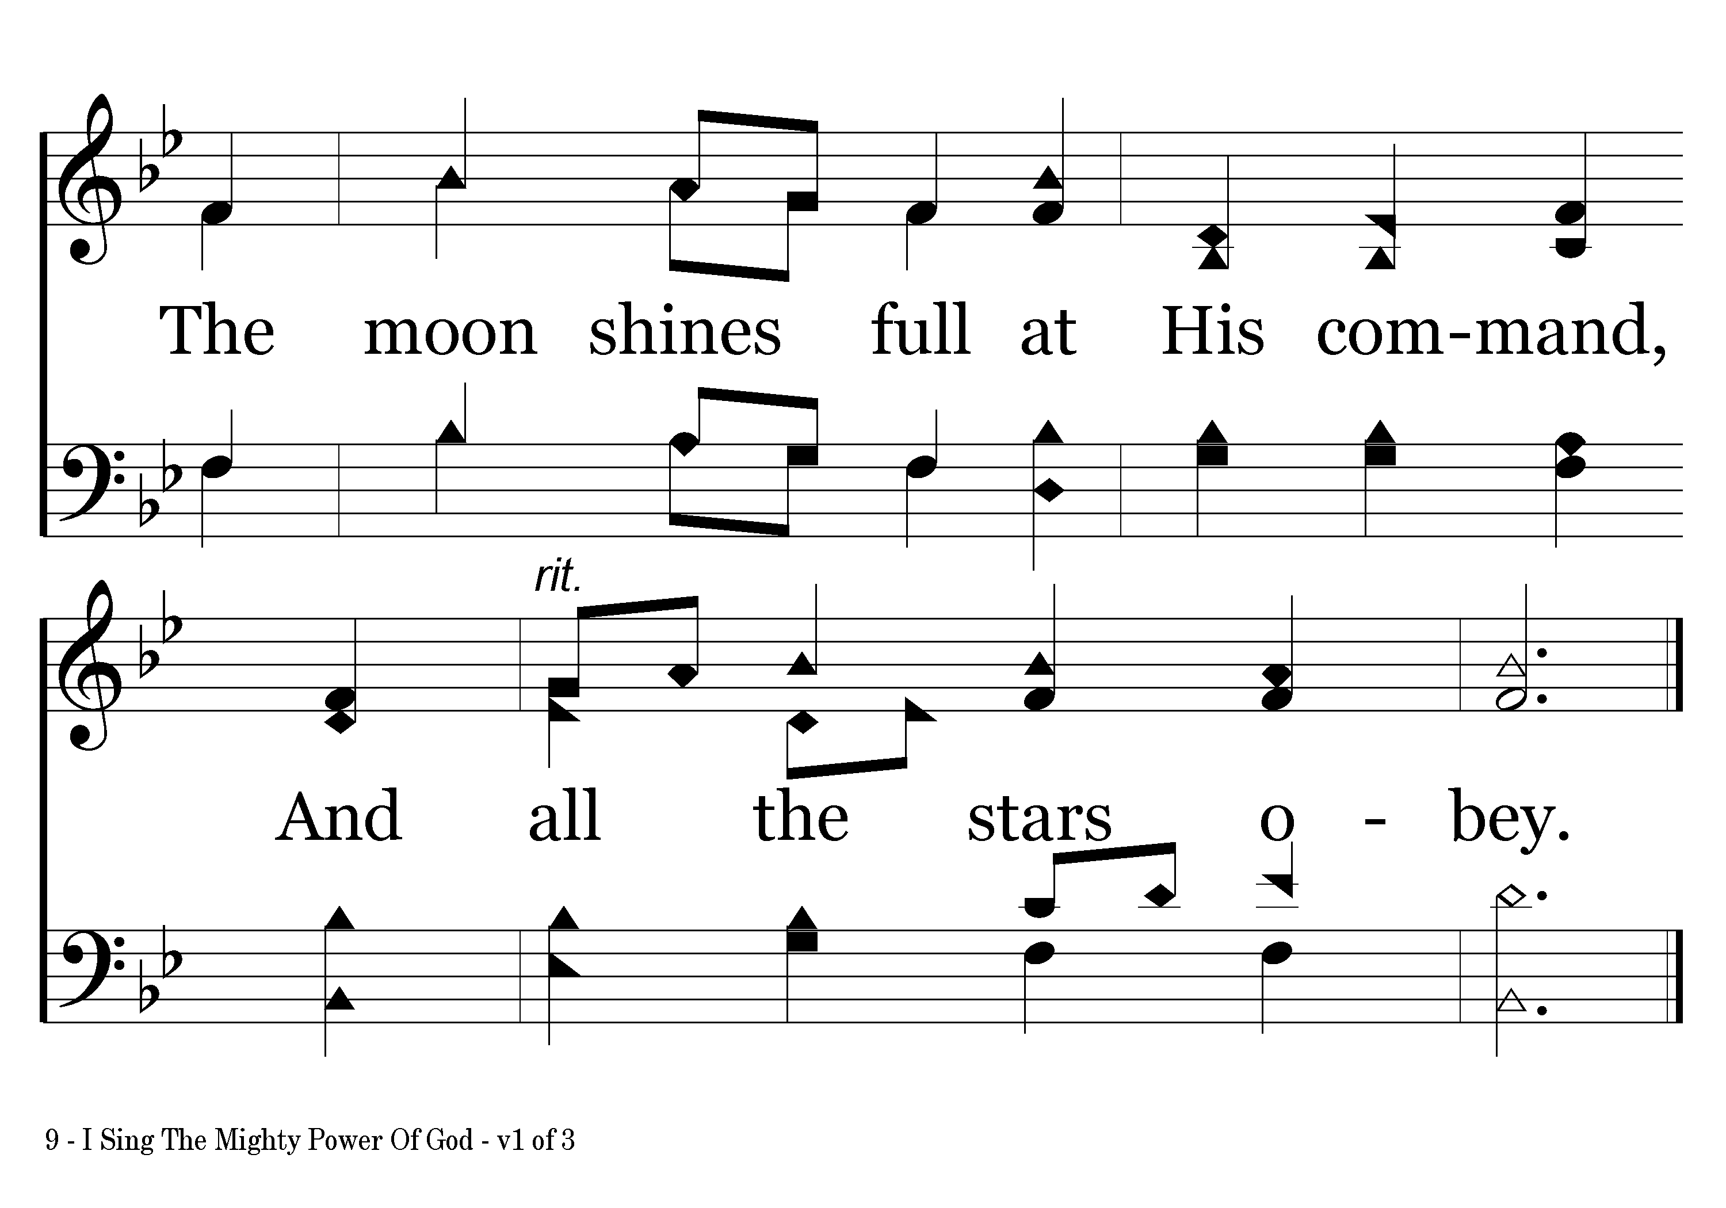
009 - I Sing The Mighty Power Of God - 1.4
End of Verse 1

Slide 6
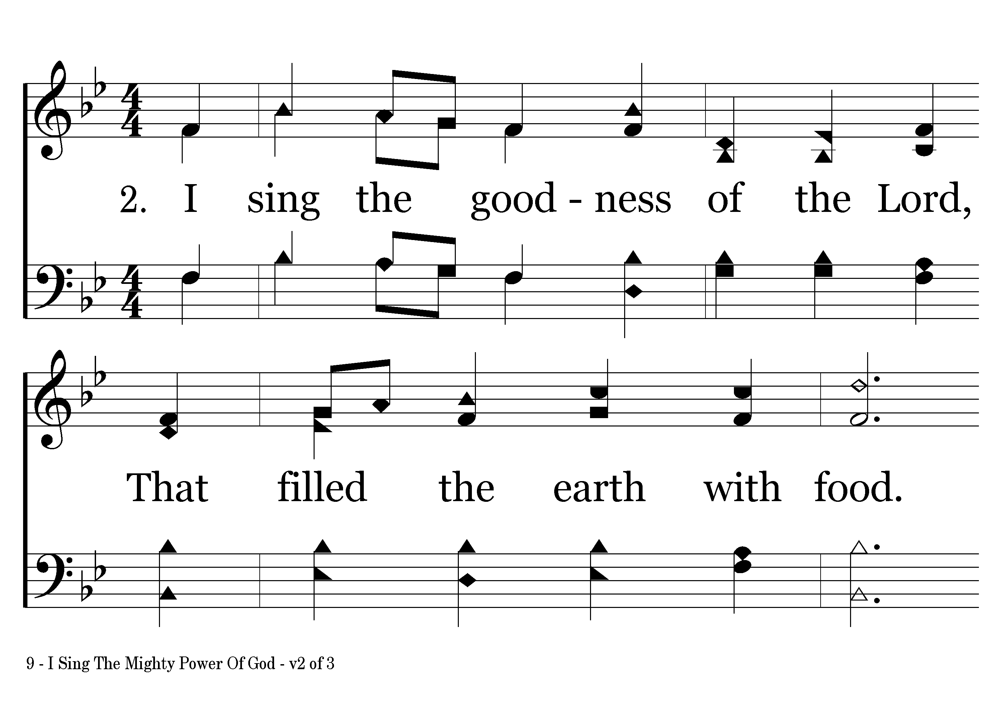
009 - I Sing The Mighty Power Of God - 2.1

Slide 7
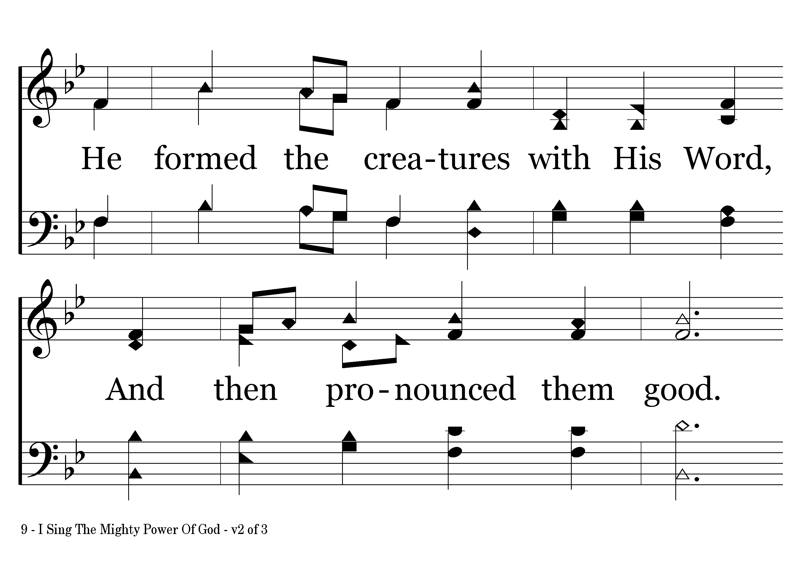
009 - I Sing The Mighty Power Of God - 2.2

Slide 8
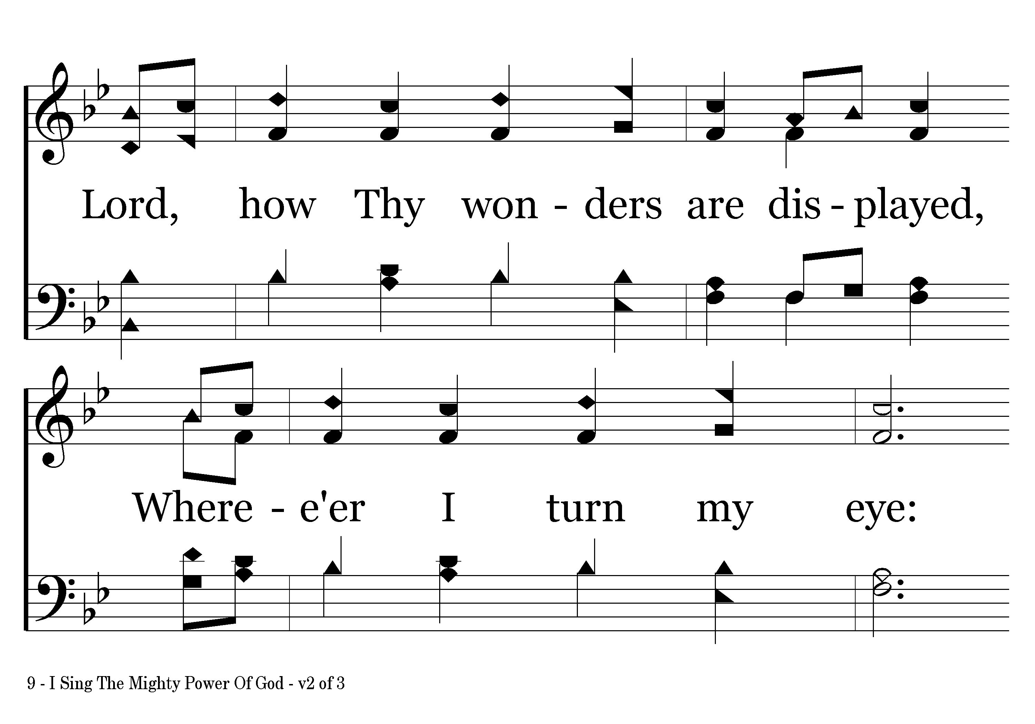
009 - I Sing The Mighty Power Of God - 2.3

Slide 9
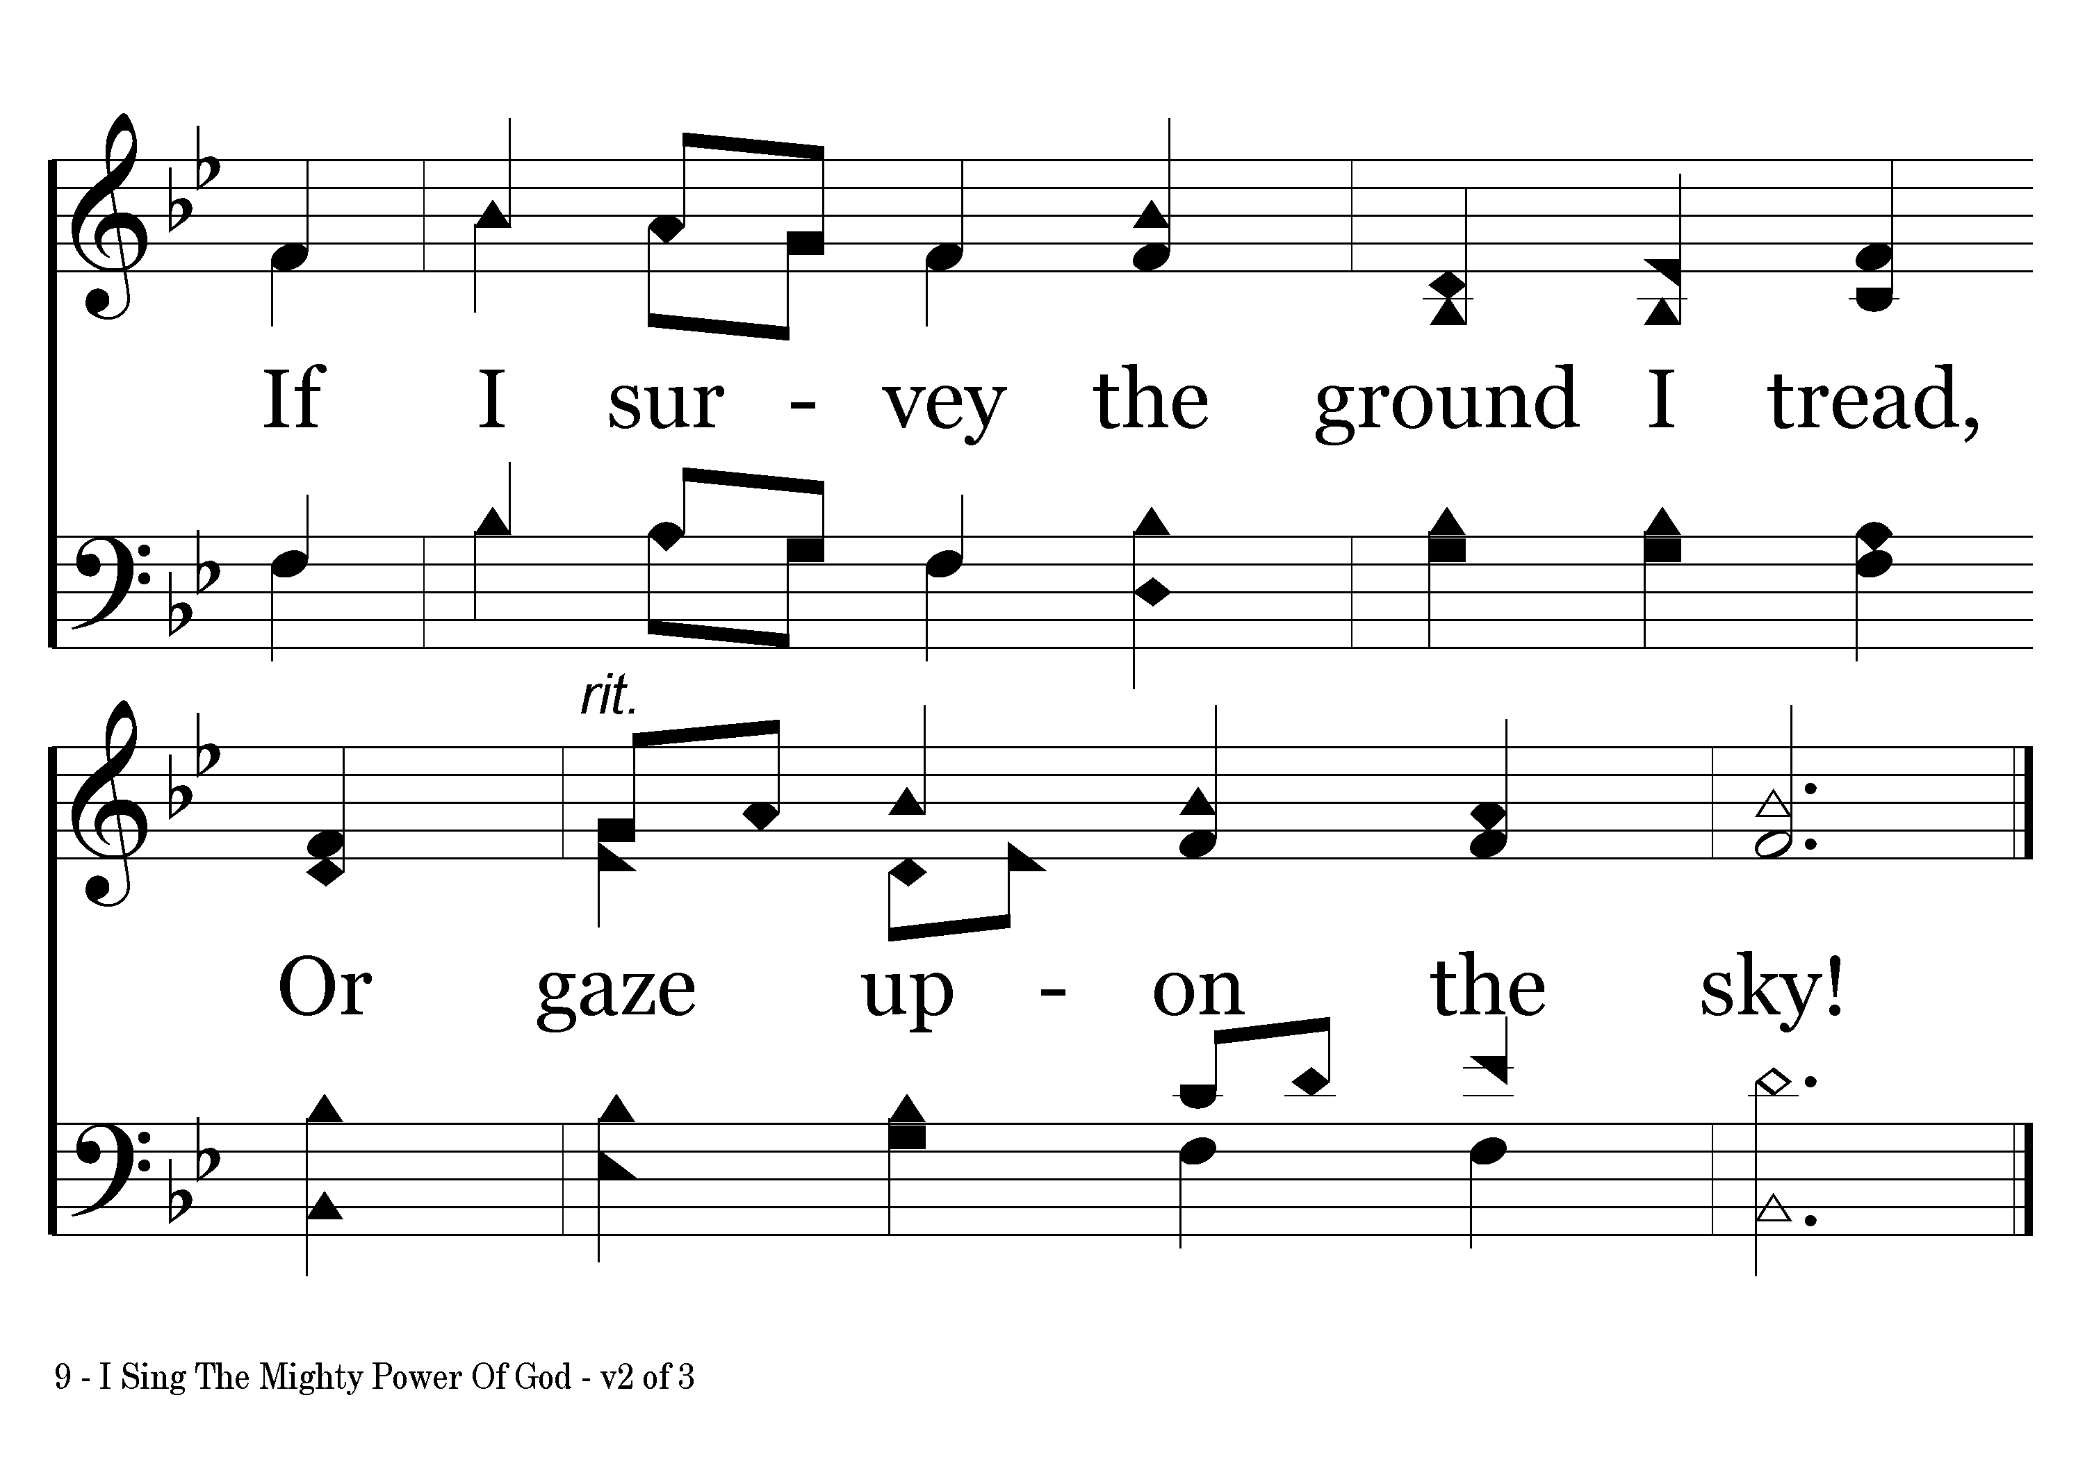
009 - I Sing The Mighty Power Of God - 2.4
End of Verse 2

Slide 10
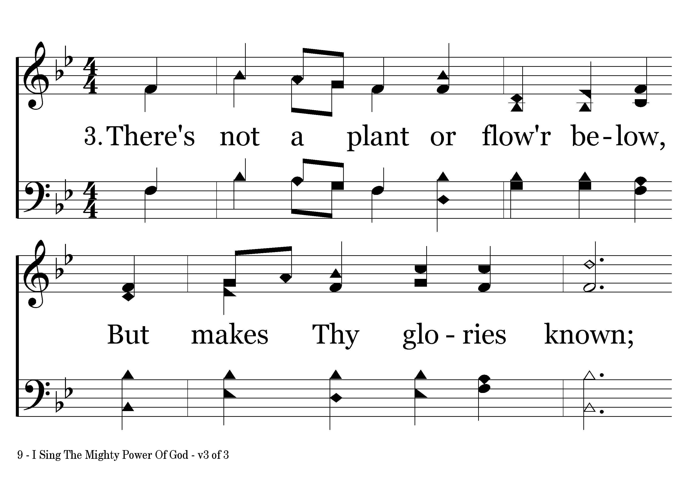
009 - I Sing The Mighty Power Of God - 3.1

Slide 11
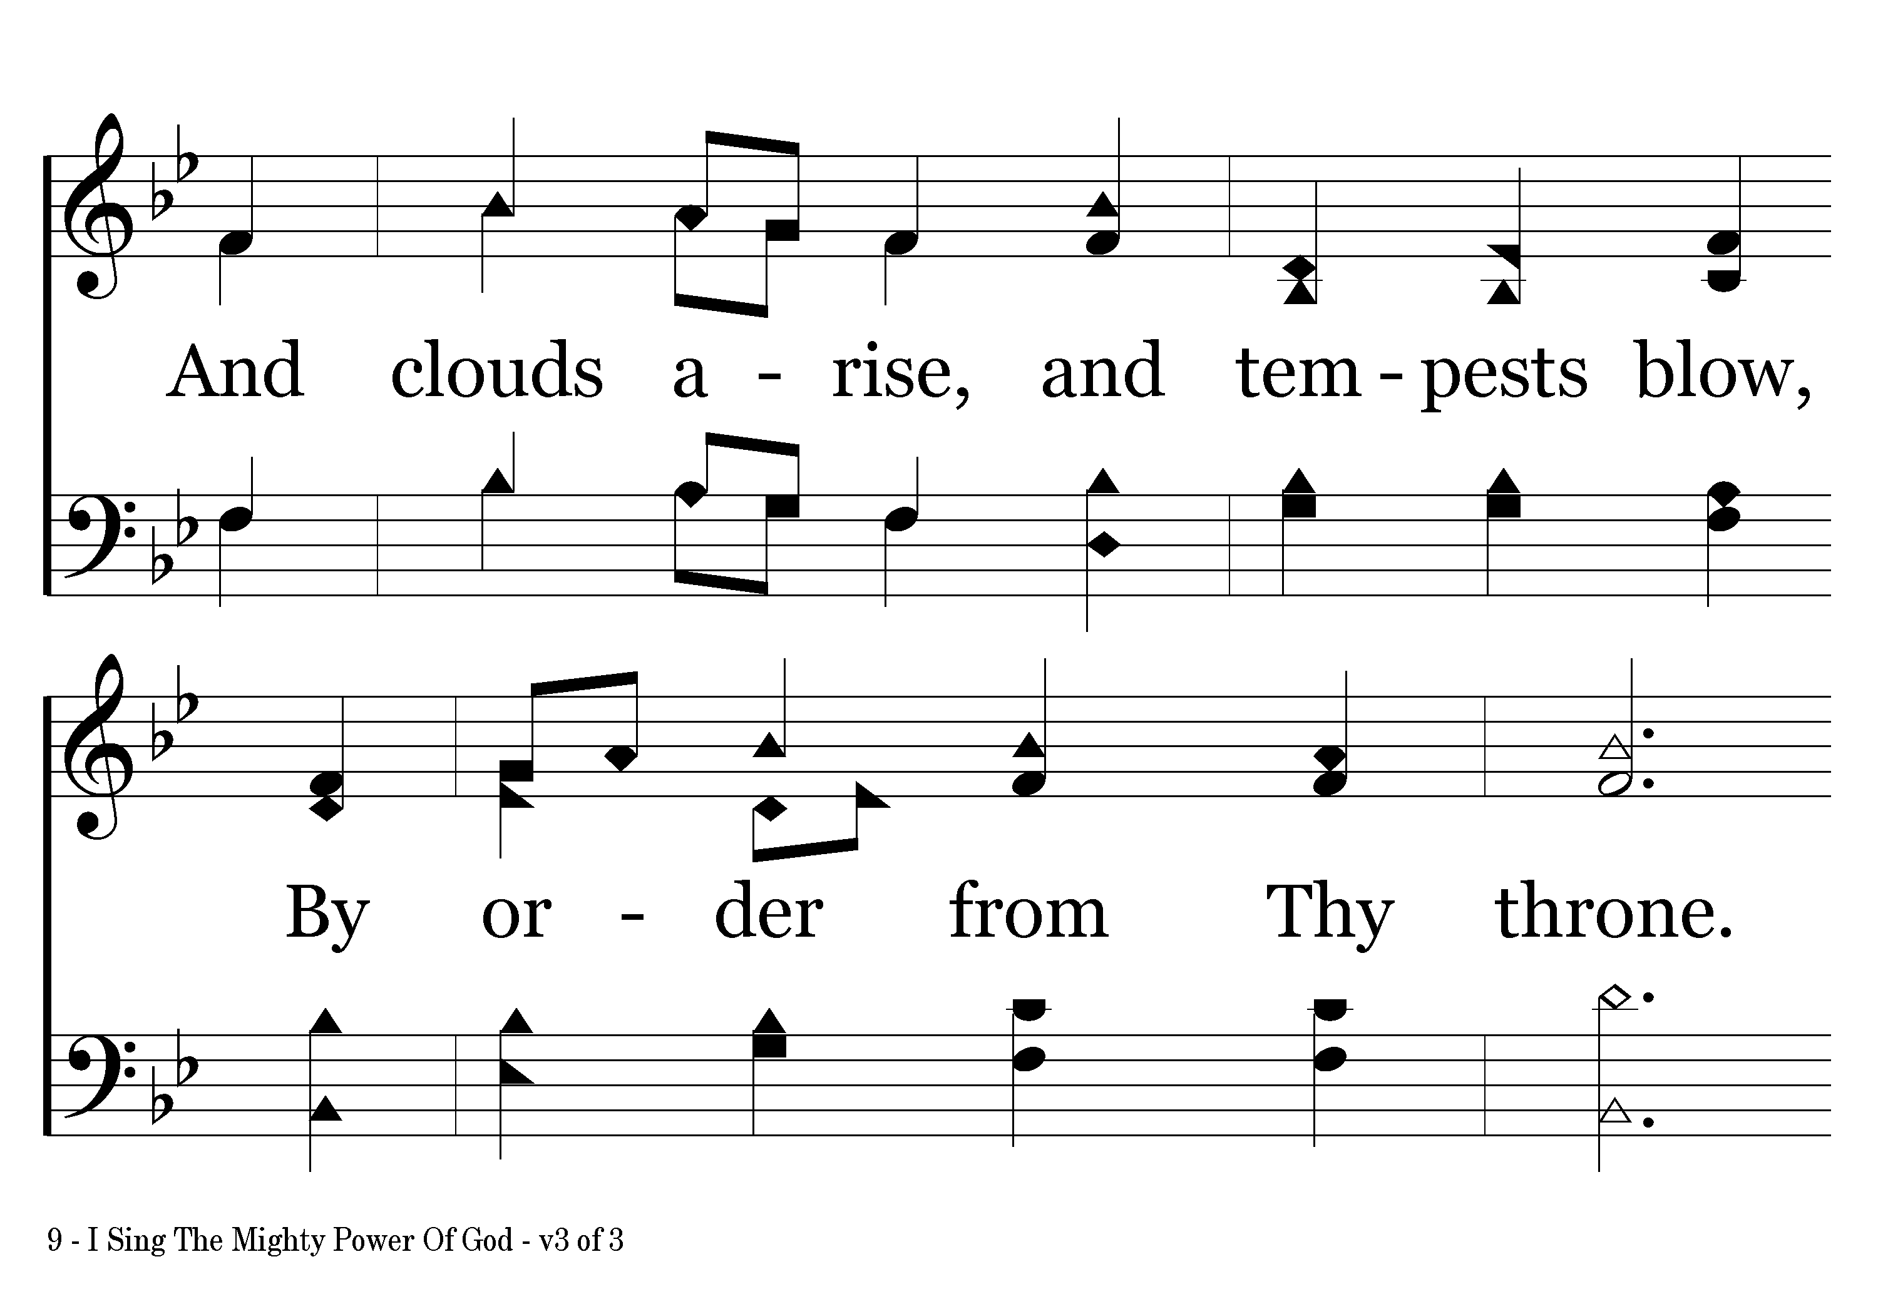
009 - I Sing The Mighty Power Of God - 3.2

Slide 12
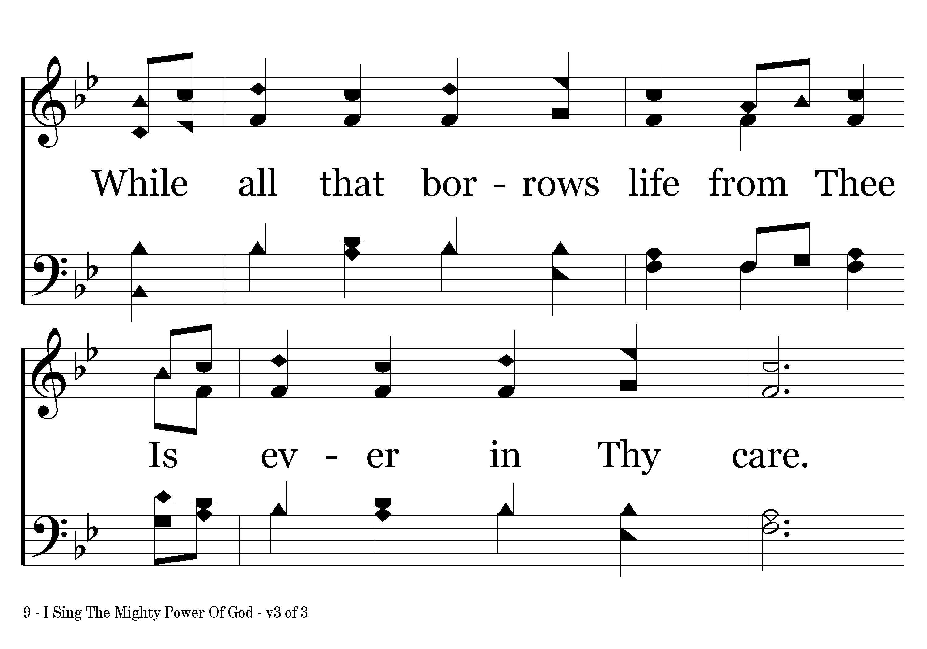
009 - I Sing The Mighty Power Of God - 3.3

Slide 13
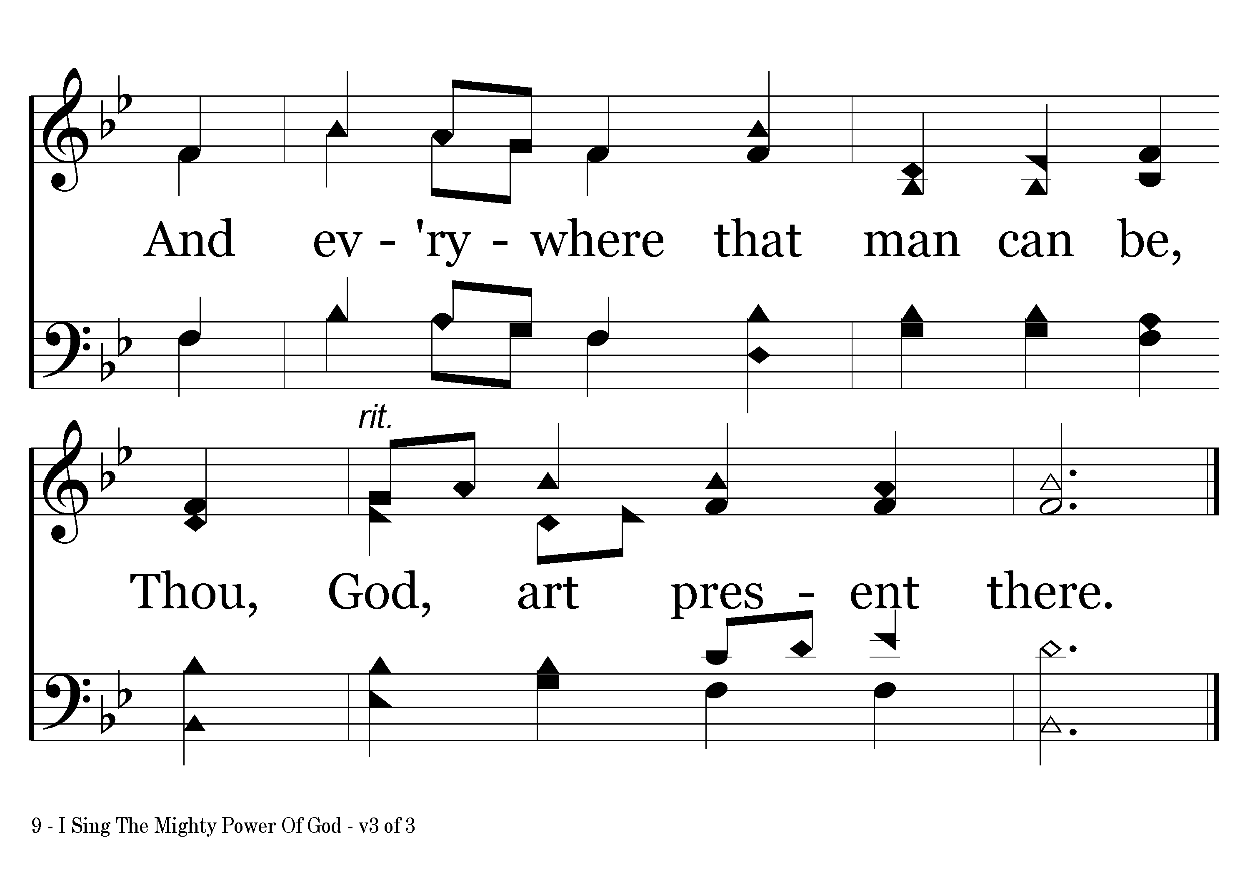
009 - I Sing The Mighty Power Of God - 3.4

Slide 14
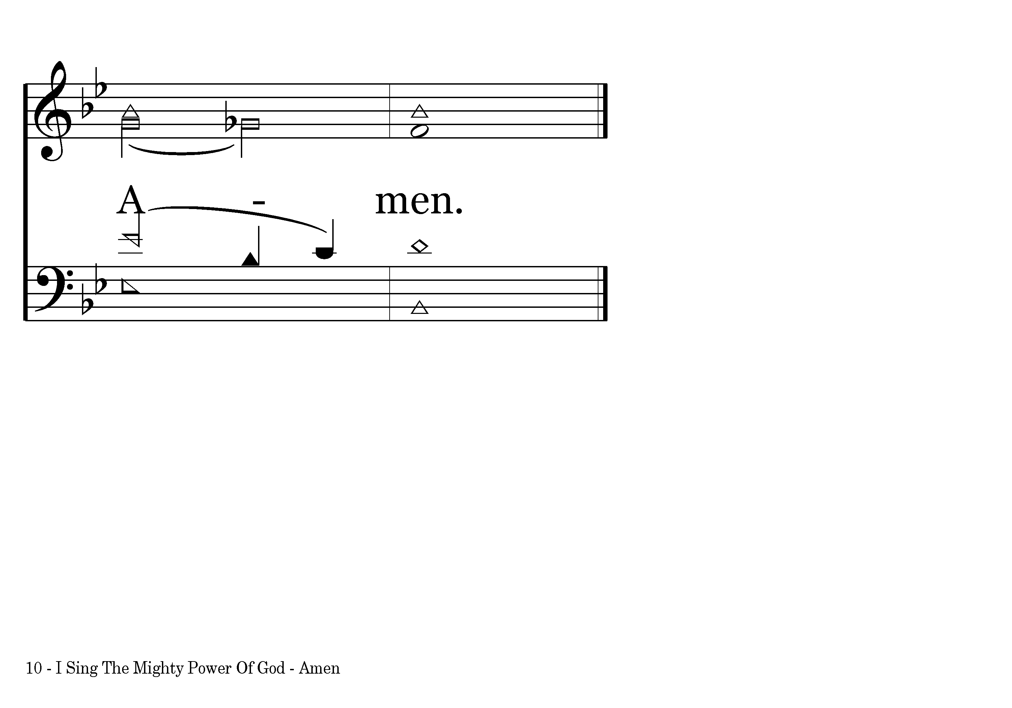
009 - I Sing The Mighty Power Of God - A.1
End of Song

